Slide 1
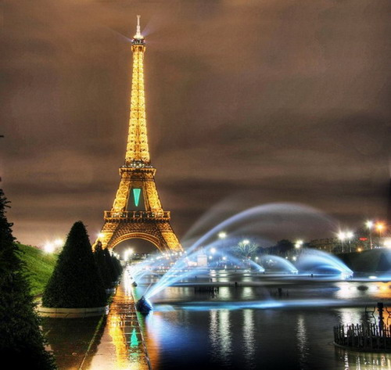
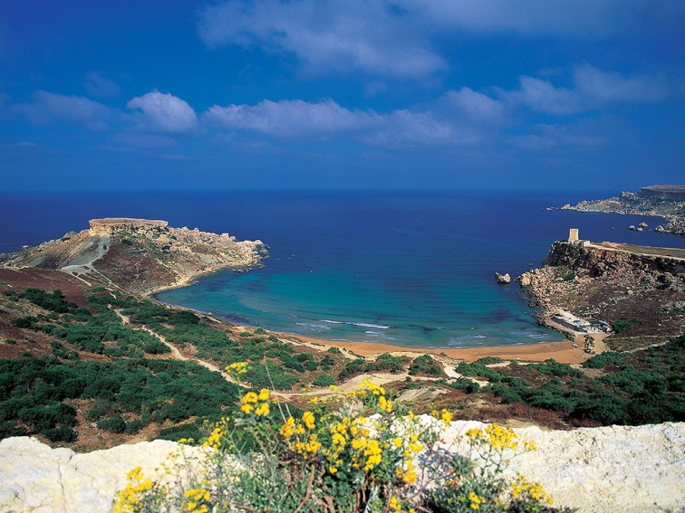
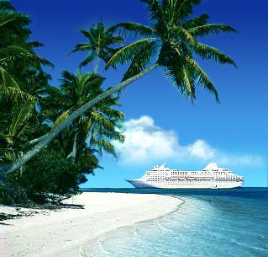
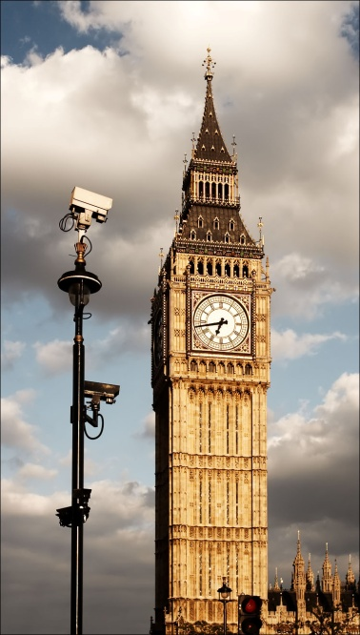
Travelling
Составитель
Учитель английского языка
МБОУ "Гимназия №1 им. Н.М. Пржевальского"
Чуранова Юлия Геннадьевна

Slide 2
Means of travelling

Slide 3
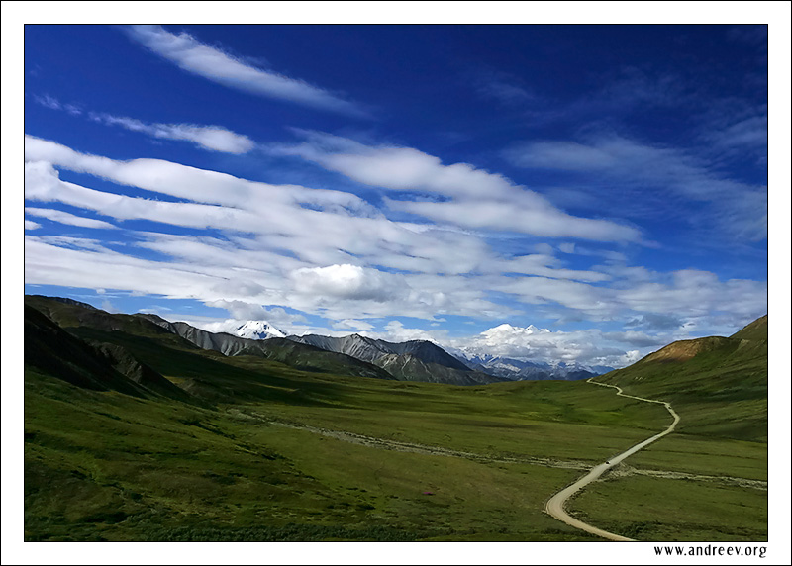
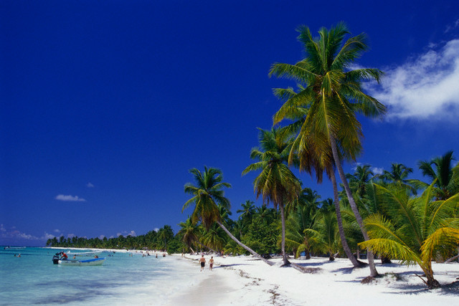
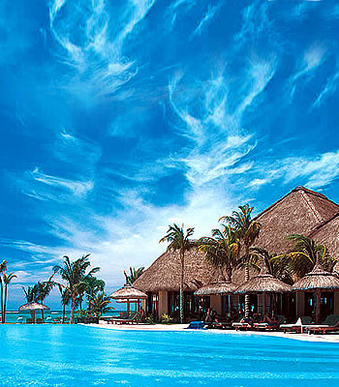
- to be fond of
- new places
- for pleasure
- on business
- go abroad

Slide 4
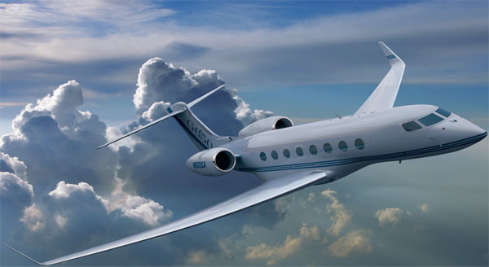
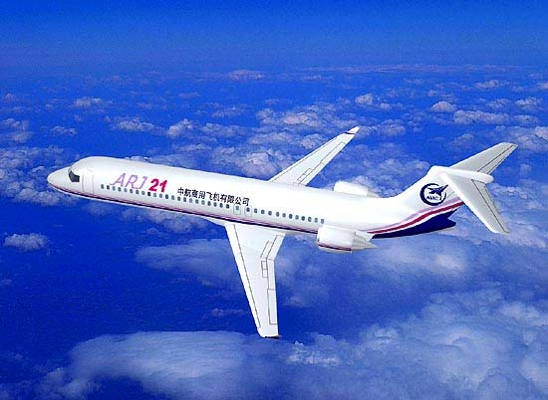
travelling by plane
- comfortable
- convenient
- expensive
- quicker
- in advance
- at the airport

Slide 5
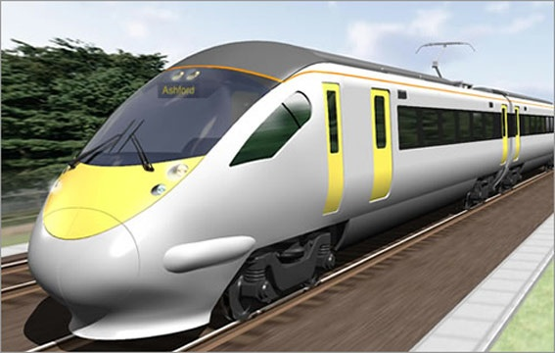
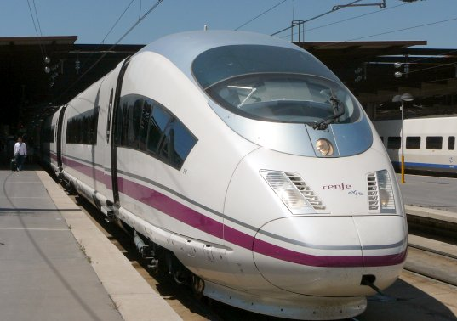
travelling by train
- speed
- comfort
- pleasure
- a splendid view
- dining-car
- a wonderful bed in a sleeper.

Slide 6
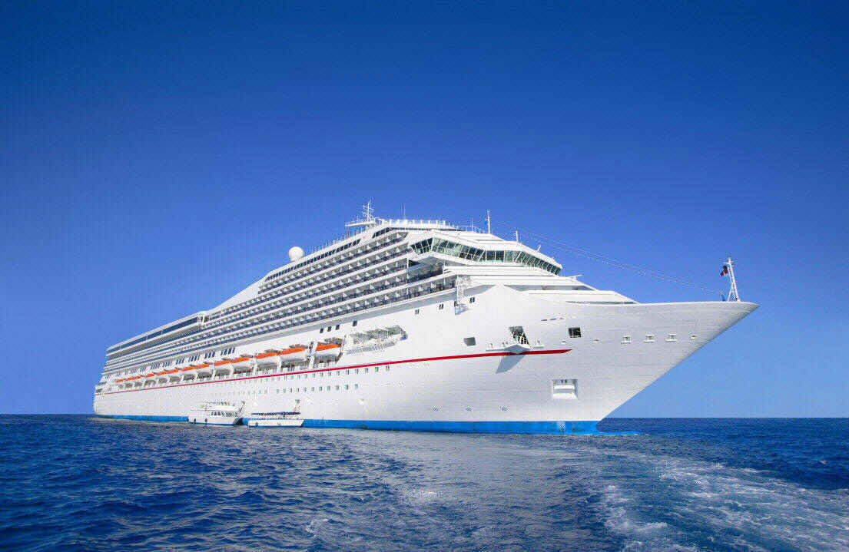
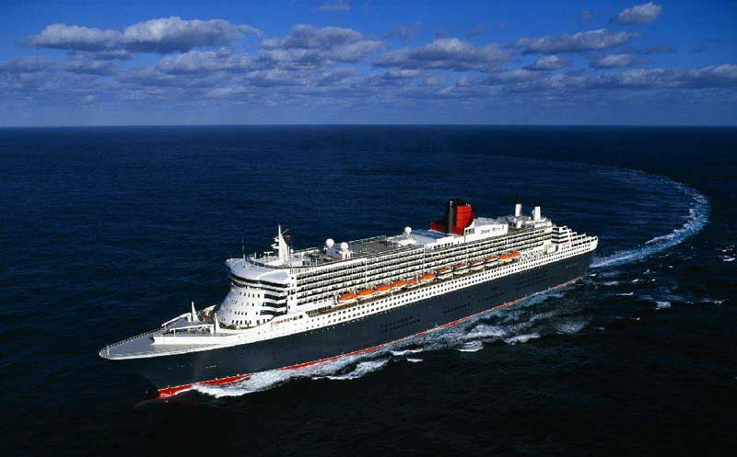
travelling by ship
- popular
- pleasant
- the deck
- the rise and fall of the waves
- fresh sea wind
- cry of the seagulls

Slide 7
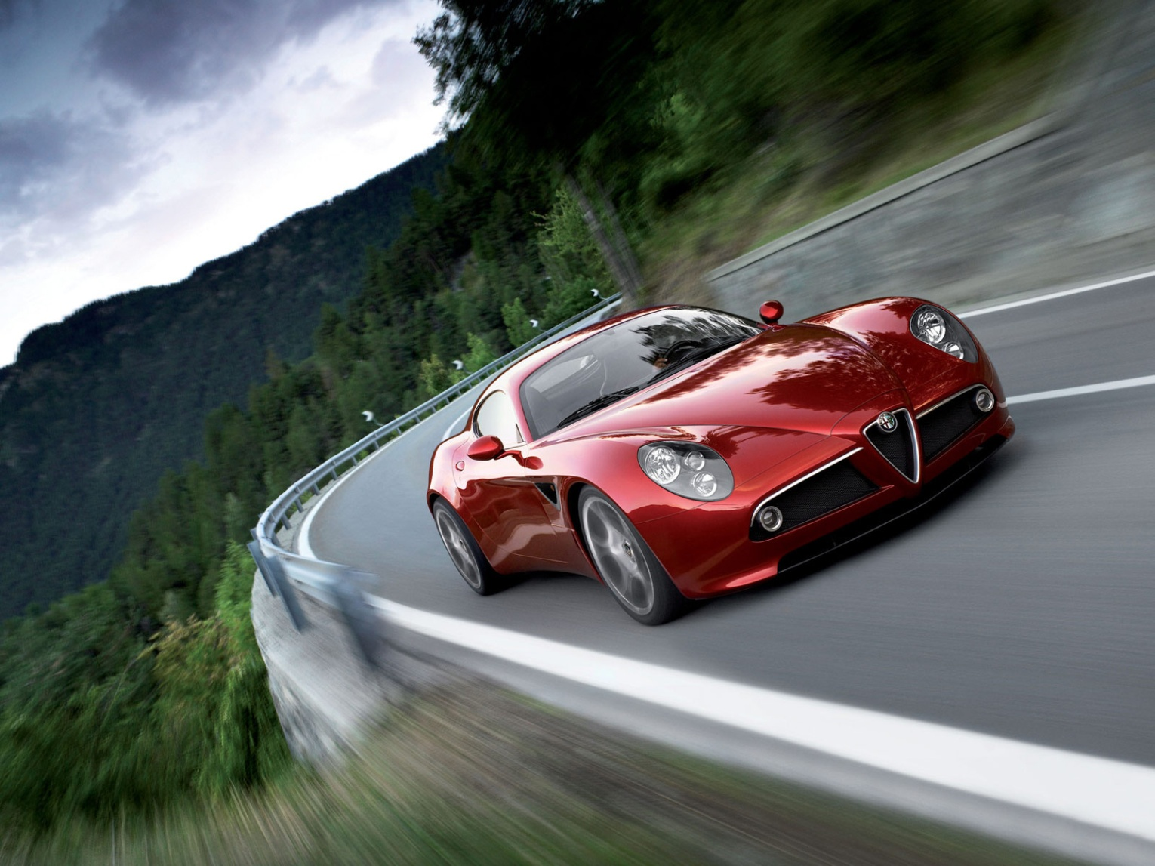
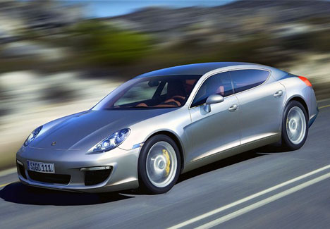
travelling by car
- interesting
- stop
- to buy tickets
- carry your suitcases

Slide 8
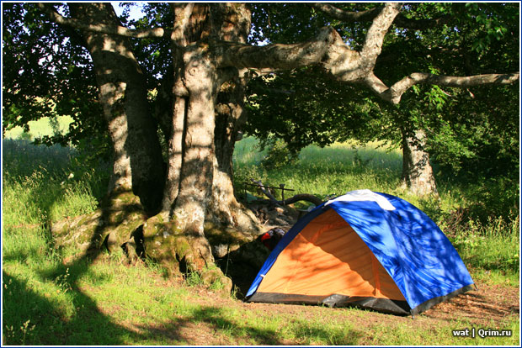
hiking and Hitch-hiking
- popular method
- on foot
- walking tours
- interesting
- among young people
- abroad

Slide 9
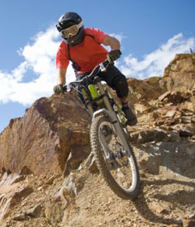
travelling by bicycle
to get from one place to another
Healthy
Stimulating
eco-friendly
allows to experience

Slide 10
the end!

