Slide 1
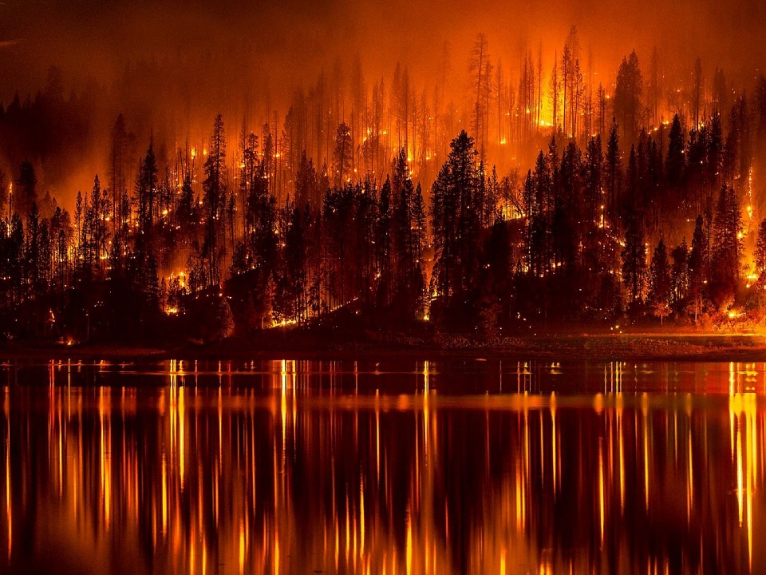
Мир без пожаров

Slide 6
Список источников
https://pixabay.com/static/uploads/photo/2015/10/16/16/59/forest-fire-991479_960_720.jpg
https://pixabay.com/static/uploads/photo/2012/04/12/19/11/fire-30231_960_720.png
https://pixabay.com/static/uploads/photo/2015/05/09/23/04/sailing-760342_960_720.png
https://pixabay.com/static/uploads/photo/2014/04/02/16/27/fire-307336_960_720.png

