Slide 1
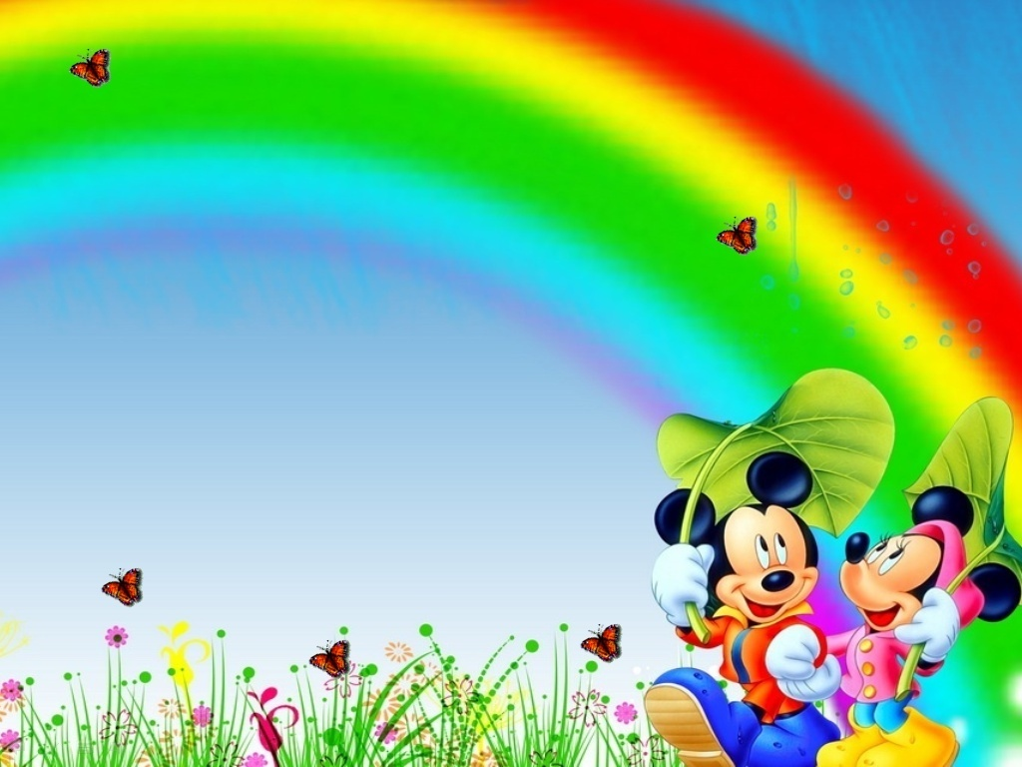

Slide 3
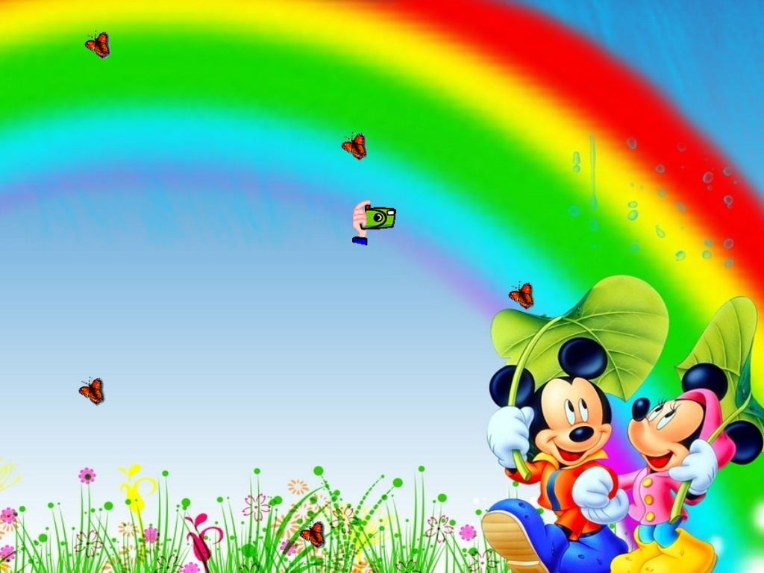

Slide 5
12%2C25%2C2%2C0%2C0&suggest_reqid=100396738141110041846722985203639&family=yes= картинки героев Диснея

